Slide 1

Covering your assets
Notes:
— Covering Your Assets Anti-Pattern
Fear of making the wrong choices.
- Wait until you have enough information to make a valid decision.
— Not that long to avoid analysis paralysis.
- Work closely with the Development team so you can correct the decision on time.
Photo by <a href="https://unsplash.com/@jasmin_sessler?utm_source=unsplash&utm_medium=referral&utm_content=creditCopyText">Jasmin Sessler</a> on <a href="https://unsplash.com/photos/egqR_zUd4NI?utm_source=unsplash&utm_medium=referral&utm_content=creditCopyText">Unsplash</a>

Slide 2

Groundhog Day
Notes:
Groundhog Day Anti-Pattern
Bill Murray - 2Feb over and over again
People don’t know WHY a decision was made, so it keeps getting discussed over and over and over.
When justifying architecture decisions it is important to provide both technical and business justifications for your decision.
If a particular architecture decision does not provide any business value, then perhaps it is not a good decision and should be reconsidered.
Photo by <a href="https://unsplash.com/@tine999?utm_source=unsplash&utm_medium=referral&utm_content=creditCopyText">Tine Ivanič</a> on <a href="https://unsplash.com/photos/u2d0BPZFXOY?utm_source=unsplash&utm_medium=referral&utm_content=creditCopyText">Unsplash</a>

Slide 3

Email driven architecture
Notes:
Email-Driven Architecture Anti-Pattern
People lose, forget, or don’t even know an architecture decision has been made and therefore cannot possibly implement that architecture decision.
Photo by <a href="https://unsplash.com/es/@markuswinkler?utm_source=unsplash&utm_medium=referral&utm_content=creditCopyText">Markus Winkler</a> on <a href="https://unsplash.com/photos/Lp4jsVg8gpY?utm_source=unsplash&utm_medium=referral&utm_content=creditCopyText">Unsplash</a>

Slide 4
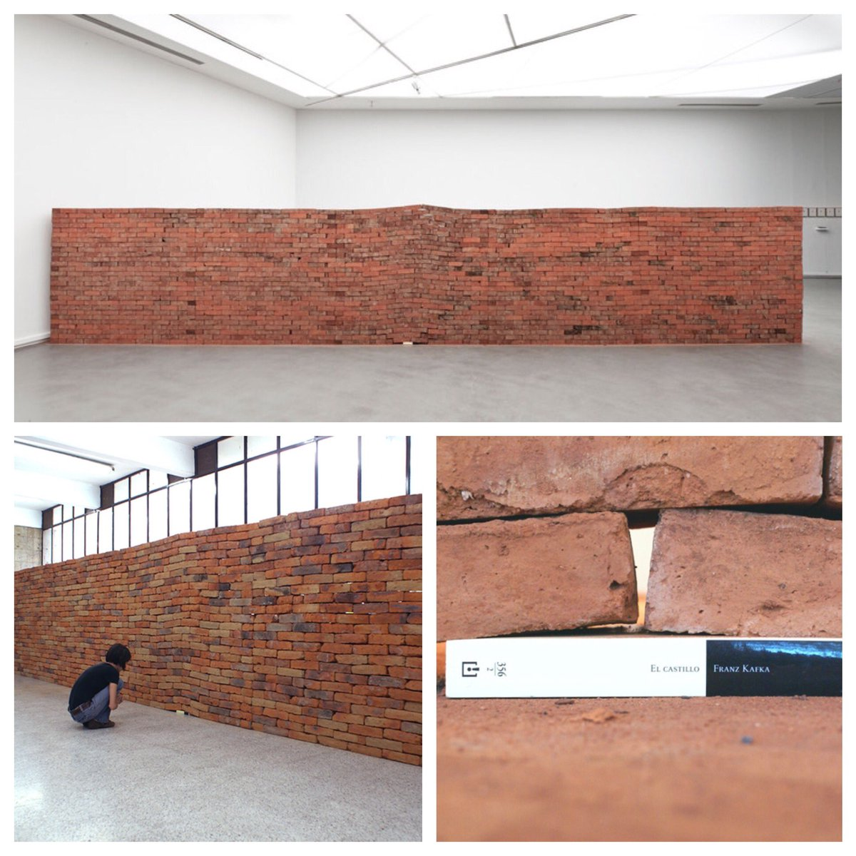
ARCHITECTURALLY SIGNIFICANT
Notes:
The Impact of a Book, Jorge Mendez Blake
Michael Nygard, a well-known software architect and author of Release It! (Pragmatic Bookshelf):
Architecturally Significant
Many architects believe that if the architecture decision involves any specific technology, then it’s not an architecture decision, but rather a technical decision.
The structure
The nonfunctional characteristics
Dependencies
Interfaces
https://www.flickr.com/photos/halfmind/39532825654

